Slide 1
The Earliest of Heroes
10541025 朱嫺蕾
10541011 鍾詩涵
10541022 韓采融
10542048 瞿發權
10546046 許勝傑
10546026 楊秉憲
10546025 嵇郁琪
N1051414 莊子萱
N1051422 黃羿寧

Slide 2

Flowers myths
In greek mythology there are many flower myths. In greece flowers are considered to be the most beautiful. They are rarely found in greece because greece is a place of rugged mountains and rocky hills. The flowers are scattered and few so that's why the are considered very beautiful when seen.
The ancient greek wondered
had been created and why
they were so beautiful the
mystery they made up stories
to explain they each of flower
had once been a handsome boy
or a beartiful girl.

Slide 3
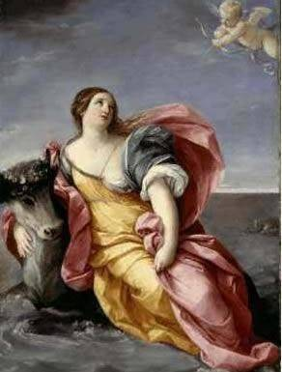
Europa
It is common in ancient Greek mythology and geography to identify lands or rivers with female figures.Thus, Europa is first used in a geographic context in the Homeric Hymn to Delian Apollo, in reference to the western shore of the Aegean Sea.In Greek mythology, Europa was the mother of King Minos of Crete, a woman with Phoenician origin of high lineage, and after whom the continent Europe was named.
The story of her abduction by Zeus in the form
of a white bull was a Cretan story; as classicist
Károly Kerényi points out, "most of the love-stories
concerning Zeus originated from more ancient
tales describing his marriages with goddesses.
This can especially be said of the story of Europa.
Europa's earliest literary reference is in the Iliad,
which is commonly dated to the 8th century BC.
Another early reference to her is in a fragment of the Hesiodic Catalogue of Women, discovered at Oxyrhynchus. The earliest vase-painting securely identifiable as Europa dates from mid-7th century BC.

Slide 4
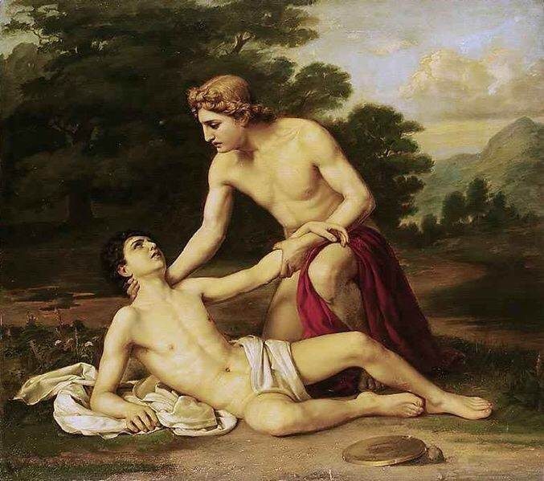
Hyakinthos
In Greek mythology, Hyakinthos was a young man admired
by Apollo and Zephyr, but killed by a discus in a jealous fight
between the two gods; a flower was allegedly named after him
when it sprang from his blood. However, Theophrastus
describes both a cultivated and a wild plant called hyakinthos,
neither of which are considered to be the modern hyacinth.

Slide 5
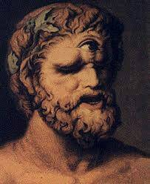
Cyclops
In the mythology of Hesiod, the Cyclops are the children of
Uranus and Gaia, who are Bronte, Sterops and ARGES,
which are characterized by "one-eyed" and only forehead
There is one eye in the middle. Uranus feared their strength
and imprisoned them in the dark abyss. Later Zeus in order
to fight Titan, they will be released from the dark abyss.
They forged a thunder and lightning for Zeus,
forged a stealth helmet for Hades,
forged the Trident for Poseidon,
forged a bow and moonlight for
Artemis, forged a bow and sun arrow for Apollo.

Slide 6
Narcissus
According to mythology, Narcissus is the river god Felix
and the water of the goddess Lili Rupo son. After the
birth of Narcissus, Lili Rios asked the famous prophet
Tirithius to inquire about the fate of his son. Tirithius
said that Narcissus could live long without seeing his face
So, although Narcissus grew up to become the most
handsome man in Greece, he never knew what he was
looking like.The beauty of Narcissus allowed all Greek
women to be dumped, but he was indifferent to all the
women whohad come to courtship.

Slide 7
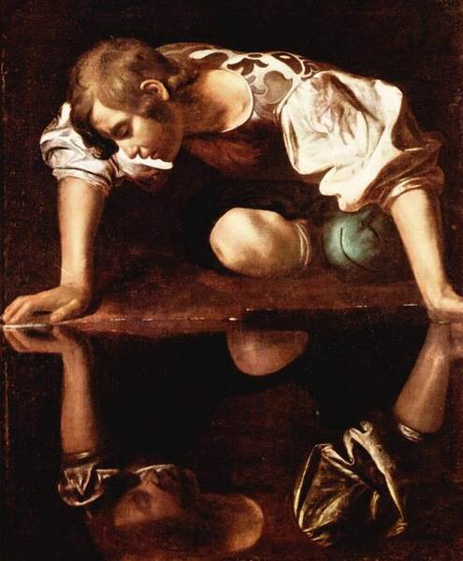
Narcissus
Later, in charge of the goddess of Heli
Hong Kong also by his beauty fascinated,
into his love can not extricate themselves.
Narcissus's plea for Euclid was
also rejected, causing Euclide to die,
leaving only the refused by him
demanded that the Nemesis of Nemesis
punish Narcissus. Nemesis agreed to
their request. When a Narcissus hunted back, he saw his handsome
face in the water. He fell in love with his own reflection, can no leave
from the pond, and finally emaciated and died. This
fulfills the prophecy of Tirithius in his childhood. A
narcissus was born in the place where Narcissus died.

Slide 8
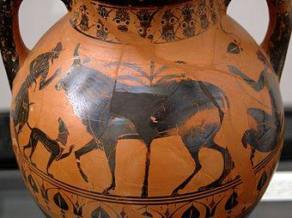
Io
Io was a priestess of the Goddess Hera in Argos.
Zeus noticed Io and lusted after her.Zeus seduced
Iraq and Russia, and then waited for her to
be persecuted by Hera,
and turned her into a
heifer.Hera then sent
Argus Panoptes, who had 100
eyes, to watch Io and prevent
Zeus from visiting her,
and so Zeus sent Hermes to
distract and eventually slay Argus.

Slide 9
Io
In order to exact her revenge, Hera sent a gadfly to sting Io
continuously, driving her to wander the world without rest.
Io eventually crossed the path between the Propontis and the
Black Sea.Caucasus by Zeus. Prometheus comforted Io with
the information that she would be restored to human form
and become the ancestress of the greatest of all heroes,
Heracles .Io escaped across the Ionian Sea to Egypt, where
she was restored to human form by Zeus.here, she gave birth
to Zeus's son Epaphus, and a daughter as well, Keroessa.She
later married Egyptian king Telegonus.

Slide 10
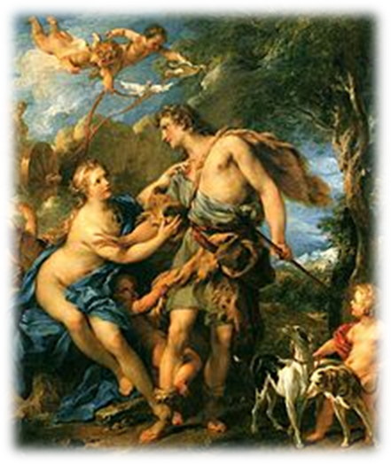
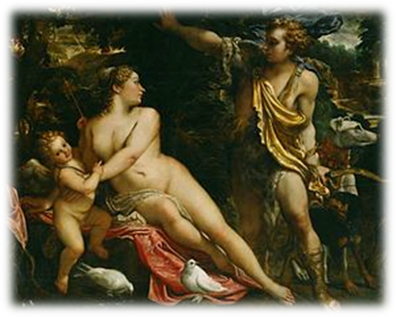


Adonis
He is described as a beautiful youth and he’s a god managing fertility.
When the baby Adonis was born ,Aphrodite fell in love with the god damn beautiful Adonis (possibly because she had been wounded by Eros‘ arrow). Aphrodite sheltered Adonis as a new-born baby and entrusted him to Persephone.
He is annually renewed, ever-youthful vegetation god ,associated with calendar deeply.His name is often applied in modern times to handsome youths.

Slide 11
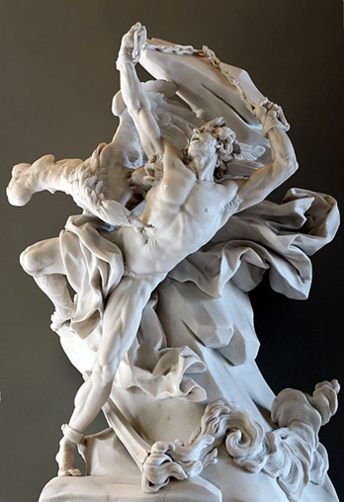
Prometheus
Prometheus meaning "forethought”, is know as the creator of mankind
He stole fire and gave it to mankind
Prometheus tricks Zeus into eternally claiming the inedible parts of cows and bulls for the sacrificial ceremonies of the gods
Subjected to eternal punishment at the will of Zeus, because of his exploits with Zeus

